Slide 1
How Do Developers React to RESTful API Evolution?
by Shaohua Wang, Iman Keivanloo, and Ying Zou
Published 2014
Presented by Christian Parker

Slide 2
What is a RESTful API?
A RESTful API is any API that follows the REST (REpresentational State Transfer) constraints:
Client-server architecture
Stateless
Cacheable
Uniform Interface
  Resources are identified in requests
  Representation has enough info for modification or deletion of the resource's state
  Self-descriptive messages
  Hypermedia as the engine of application state (HATEOAS)
Layered System
Code on Demand (Optional)

Slide 3
Data Collection
The APIs considered were extracted from a list of most popular APIs in ProgrammableWeb.
Only APIs with multiple versions and documentation for multiple versions were kept.
Any APIs with the same domain or company as another API in the list were merged or discarded.
All publicly available versions of each API were considered.
This narrowed the authors down to 11 web APIs.

Slide 4
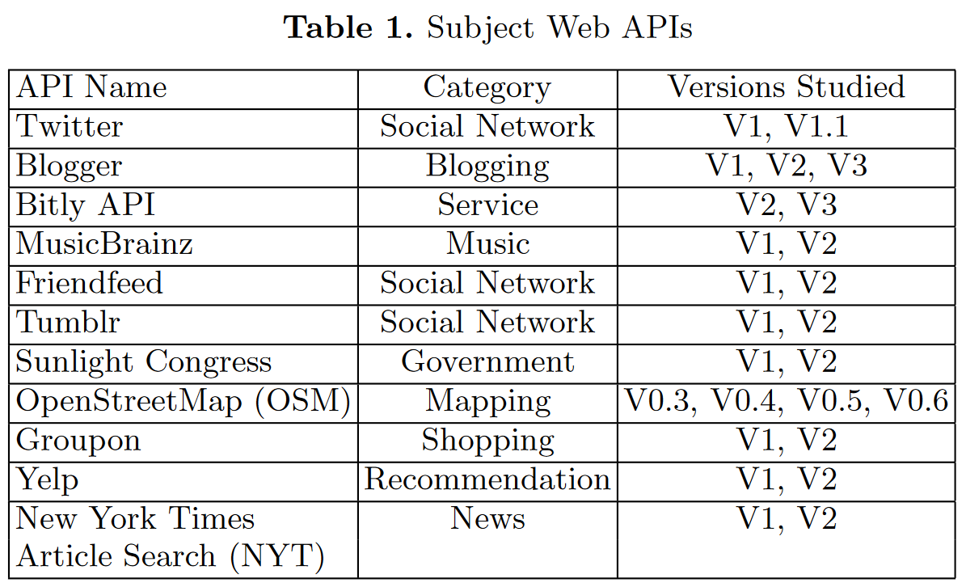

Slide 5
Stack Overflow
Posts were retrieved from Stack Overflow using StackExchange Data Explorer.
A keyword was defined for each web API. For example, "twitter".
Wild-card search to mine posts tagged with labels including the keyword.
46,646 posts with labels including “twitter” were retrieved.
Posts were retrieved on May 1st, 2014.

Slide 6
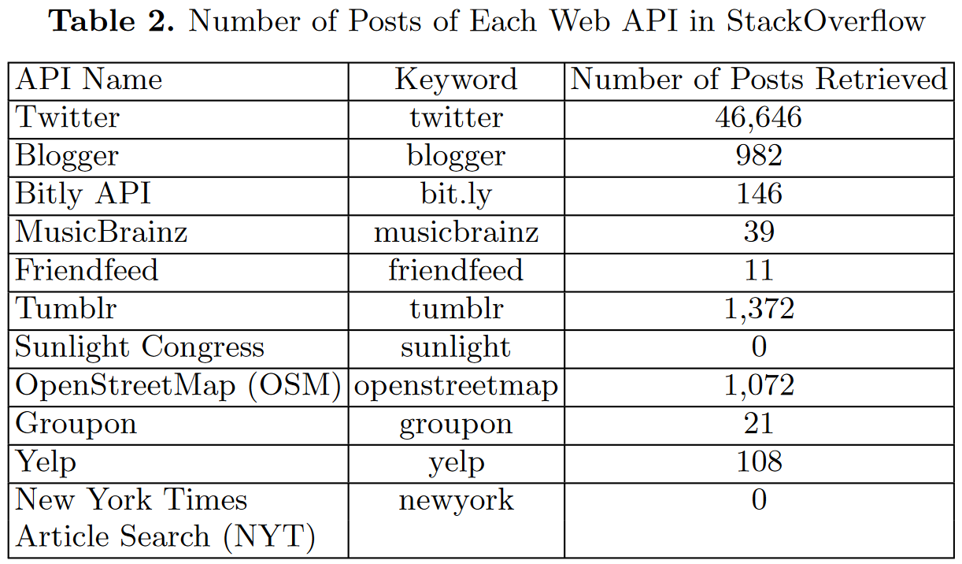

Slide 7

3 Research Questions
What are the change types of web API evolution?
Which types of changes trigger more questions from client code developers?
Which types of changes trigger more questions from client code developers?

Slide 8
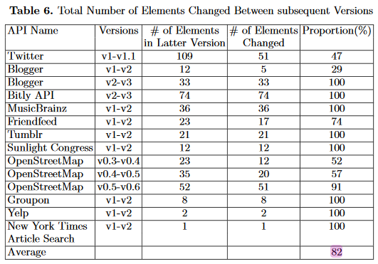
What are the change types of web API evolution?
Three categories of changes
  API-level
  Method-level
  Parameter-level
After categorization, the average proportion of changed elements (methods and parameters) between versions is 82%.
API-level change types were excluded from counting because they are typically applicable to all methods.

Slide 9
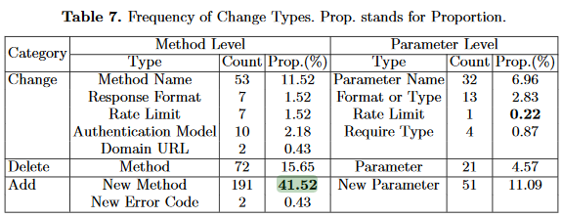
What are the change types of web API evolution?
The four most common changes were:
Add method
Delete method
Change method
Add parameter
Add method accounted for 41.52% of these changes.

Slide 10
Which types of changes trigger more questions from client code developers?
How many questions were generated on Stack Overflow per change of each type?
Add Method is the highest with an average of 63 questions per change.
Method-level changes result in more questions than parameter-level changes.

Slide 11
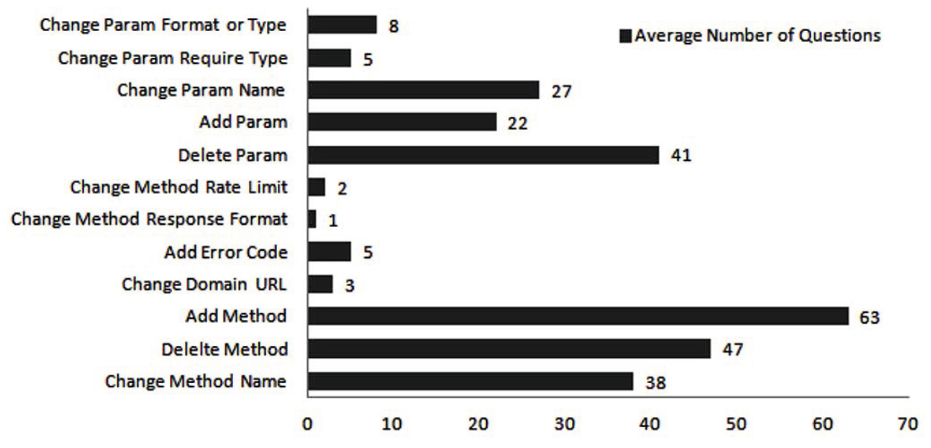

Slide 12
Which types of changes trigger more questions from client code developers?
Score
The difference between up-votes and down-votes.
View Count
The number of times the question has been viewed.
Answer Count
The number of answers for the question.

Slide 13
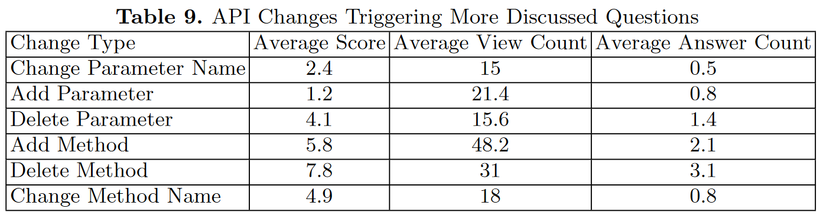
Which types of changes trigger more questions from client code developers?
Posts from the top six change types are considered.
Delete Method posts receive the highest scores and most answers relative to other change types.
Add Method posts receive higher views relative to every other change type.
Communication and answers might be easier to find on deleted method posts. Presumably because deleting methods breaks client applications.

Slide 14
Critiques
Data Collection
The majority of the data came from Twitter.
Data Separation
The study considers merged and divided methods as deleted and the methods that replace them added.
Ambiguous Conclusions
The study fails to clearly analyze why change types receive various levels of engagement.

Slide 15
Conclusion
Adding new methods to APIs results in the most questions and views per change
Deleting methods results in the most engagement
Future research should
• Collect larger data sets from a variety of sources
• Dig deeper into developer reactions with case studies

